Slide 1
Biosignal Processing
July 28, 2022

Slide 2
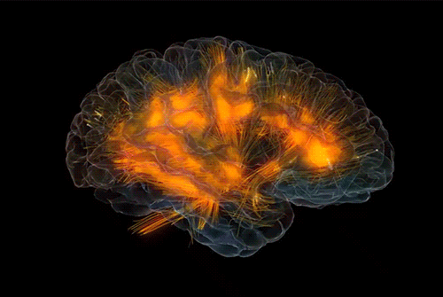

Accurate Biosignal Representation Starts with Processing
Physiological Energy
Measuring Equipment
Transducer
Computer
Amplifier
Analog-Digital Converter
Signal Processing
Feature Extraction
Classification

Slide 3
Accurate Biosignal Representation Starts with Processing
Physiological Energy
Measuring Equipment
Transducer
Computer
Amplifier
Analog-Digital Converter
Signal Processing
Feature Extraction
Classification

Slide 4
Workshop Objectives
01
Signal
Sampling
02
Time and
Frequency Domains
03
Noise
04
Filtering

Slide 5
Part 1:
Signal Sampling

Slide 6

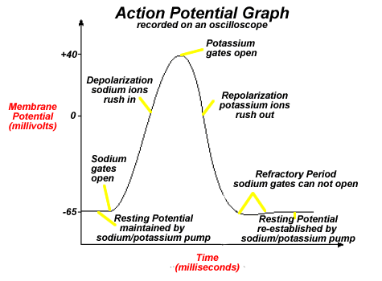
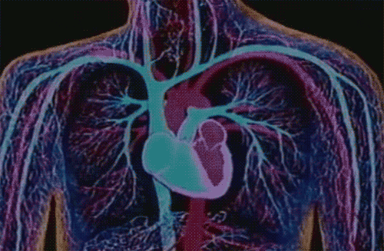
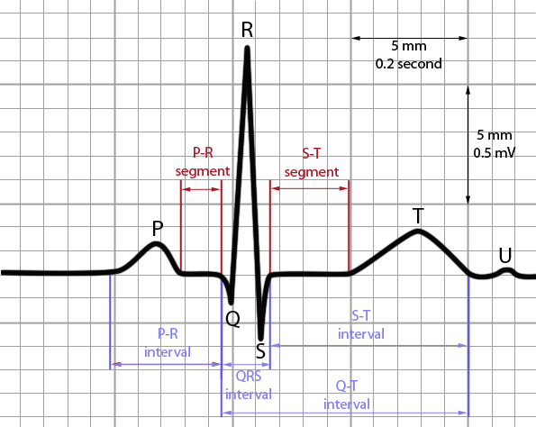
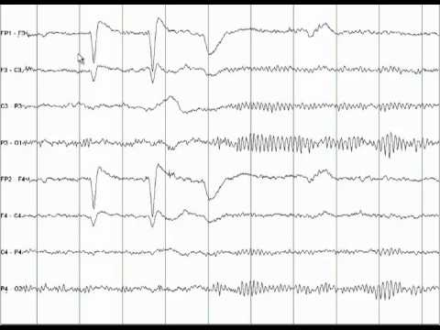
Continuous System
Discrete Representation
Notes:
Neural signals, whether they are representative of neural activity in a single neuron, the heart, or brain exist on a continuous plane meaning that between any two sampled time points, there are an infinite number of data points that exist. We are limited by computational speed, ability, and memory therefore, we cannot realistically measure these continuous signals. Rather, we must represent them as samples of their continuous form.
Biosignals are represented by a continuous range of voltages, can take on an infinite number of possible values.
Computers are digital and can only acquire discrete voltage levels at discrete timepoints

Slide 7
Continuous System
Discrete Representation
Reconstruct the continuous signal
(with infinite # of possible values)
using digital signals (finite # of possible values)
Notes:
Neural signals, whether they are representative of neural activity in a single neuron, the heart, or brain exist on a continuous plane meaning that between any two sampled time points, there are an infinite number of data points that exist. We are limited by computational speed, ability, and memory therefore, we cannot realistically measure these continuous signals. Rather, we must represent them as samples of their continuous form.
Biosignals are represented by a continuous range of voltages, can take on an infinite number of possible values.
Computers are digital and can only acquire discrete voltage levels at discrete timepoints

Slide 8
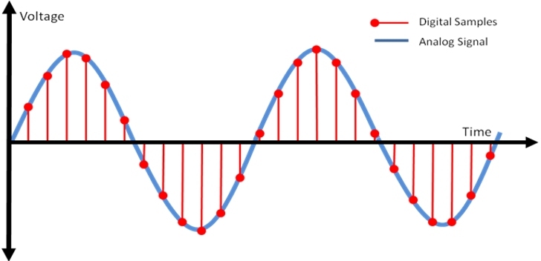
Sampling Rate
Sample the continuous signal at discrete time points at a constant rate (sampling frequency)
Connect the discrete voltage values at the sampled times to reconstruct/represent continuous signal

Slide 9
Sampling Rate
How do we know if our sampling rate accurately represents our measured signal?

Slide 10
Sampling Rate
How do we know if our sampling rate accurately represents our measured signal?
The Nyquist Theorem!

Slide 11
Nyquist Theorem
We must sample a signal at a rate that is at least 2x higher than the highest frequency in the signal

Slide 12
Nyquist Theorem
We must sample a signal at a rate that is at least 2x higher than the highest frequency in the signal
Let’s practice choosing our sampling frequency!

Slide 13
Nyquist Theorem
We must sample a signal at a rate that is at least 2x higher than the highest frequency in the signal
Example 1: We want to measure a Human ECG signal (heart activity). The clinically defined signal bandwidth is 0.05-100 Hz. What should our sampling frequency be?

Slide 14
Nyquist Theorem
We must sample a signal at a rate that is at least 2x higher than the highest frequency in the signal
Example 2: We want to measure the alpha wave activity in an EEG signal. What is the signal bandwidth? What is the minimum sampling frequency to accurately represent the signal?

Slide 15
Nyquist Theorem
We must sample a signal at a rate that is at least 2x higher than the highest frequency in the signal
What happens if we sample below the Nyquist frequency?

Slide 16
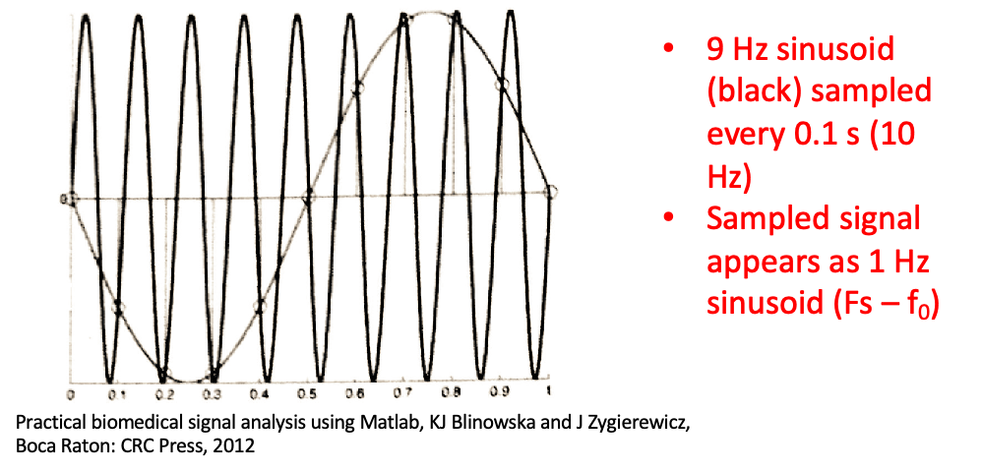
Aliasing and the Nyquist Theorem
Aliasing!

Slide 17
Aliasing and the Nyquist Theorem
Aliasing!
https://www.youtube.com/watch?v=yr3ngmRuGUc

Slide 18
Activity 1: ECG signal and Aliasing

Slide 19
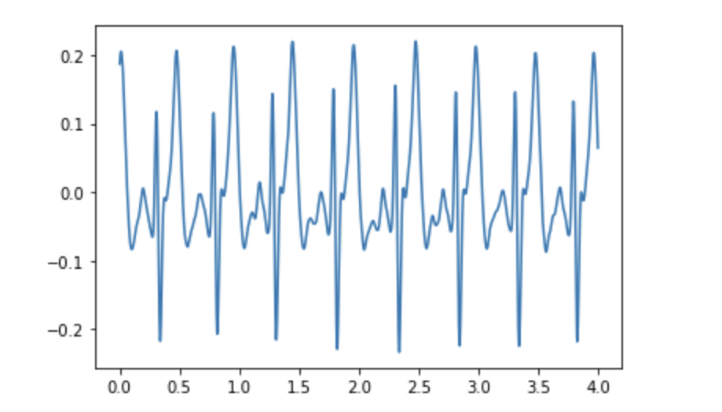
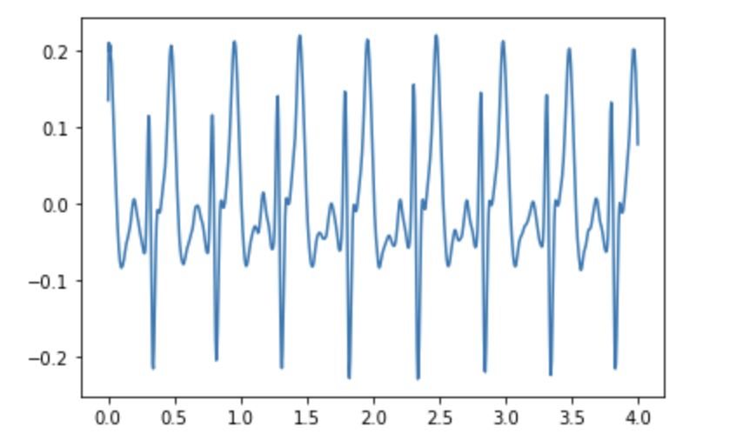
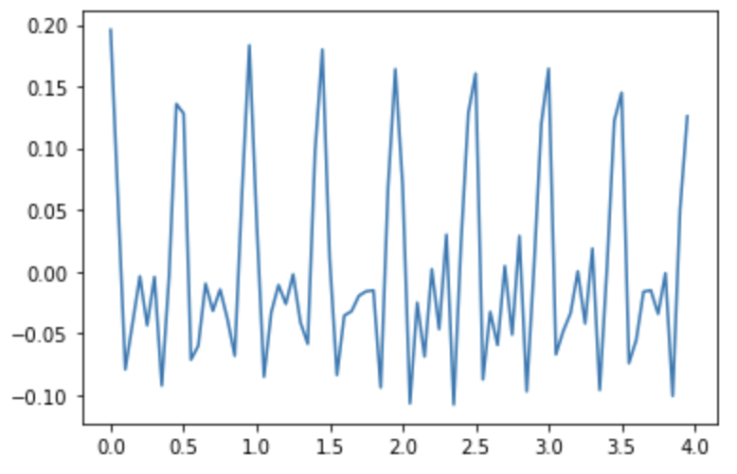
Activity 1: ECG signal and Aliasing
2000 Hz
200 Hz
200 Hz

Slide 20


Why not always have a high sampling frequency?
Can reconstruct the original signal accurately
Have to store a lot of data (Need more storage space)
Have to collect & save the data quickly
(Need high processing power)

Slide 21
Part 2:
Time and Frequency Domain
Notes:
Now that we have sampled our signal and reconstructed it, let’s consider how we can visualize our signal in both the time and frequency domains

Slide 22
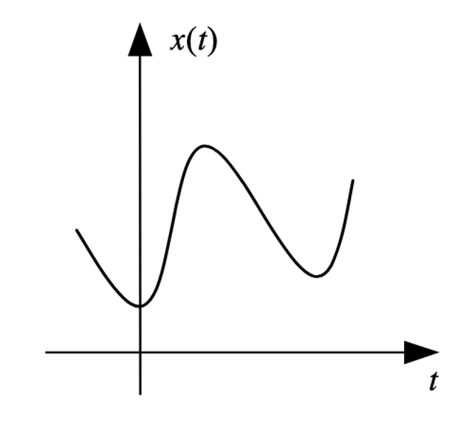
Time and Frequency Domains
Notes:
We learned that fundamentally a signal is characterizing a process as a function of the other. Specifically, we look at the relationship between an independent and dependent variable. However, particularly in the case

Slide 23
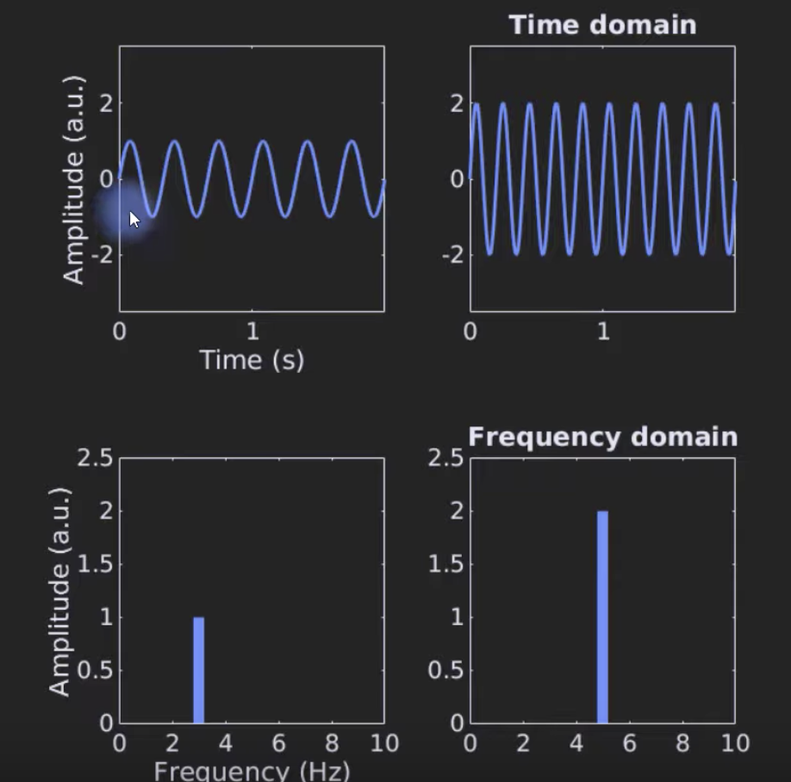
Time and Frequency Domains
https://www.youtube.com/watch?v=fYtVHhk3xJ0

Slide 24
Time and Frequency Domains
How do we interpret complex signals in the frequency domain?
Notes:
We learned that fundamentally a signal is characterizing a process as a function of the other. Specifically, we look at the relationship between an independent and dependent variable. However, particularly in the case

Slide 25
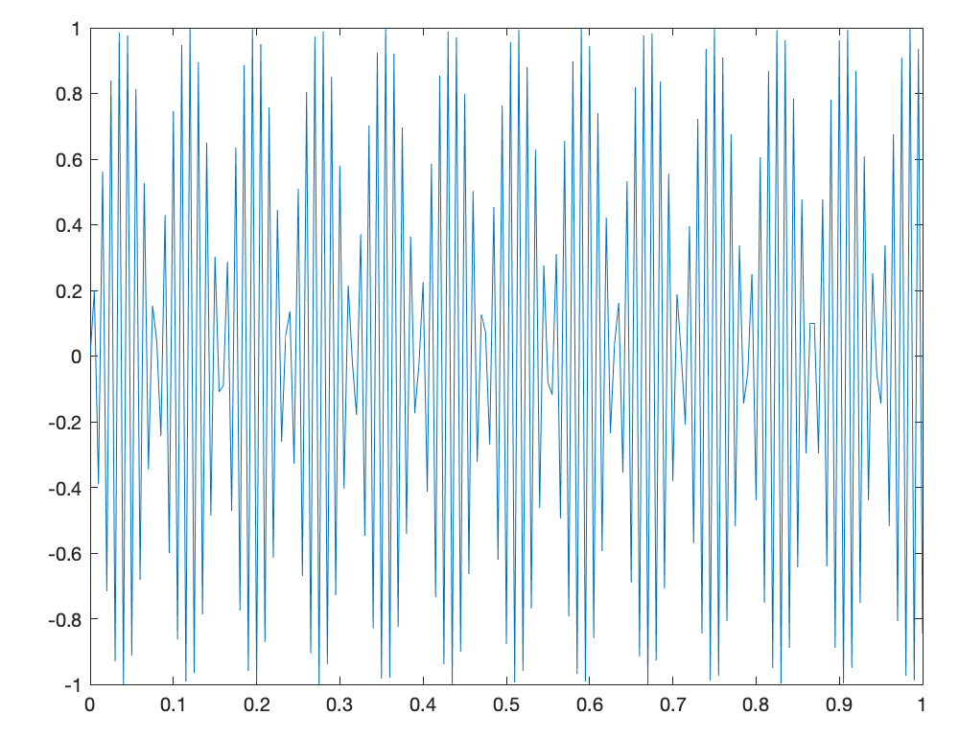
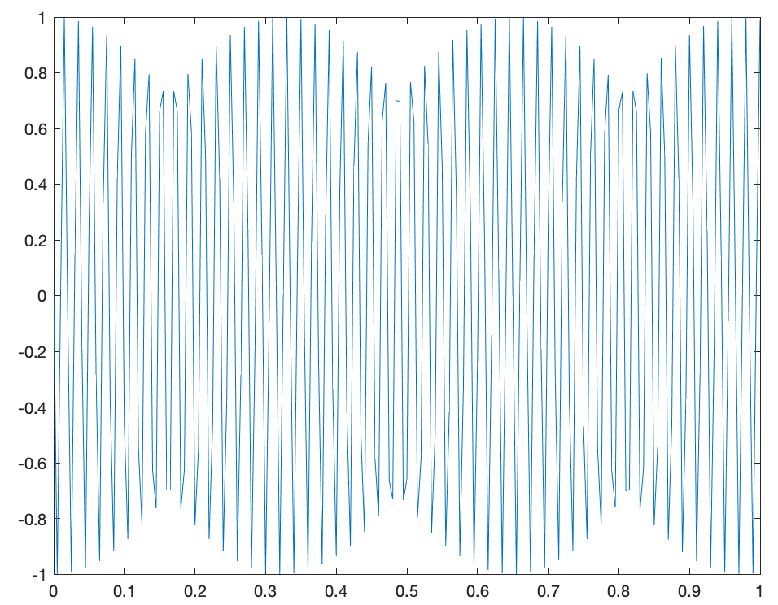
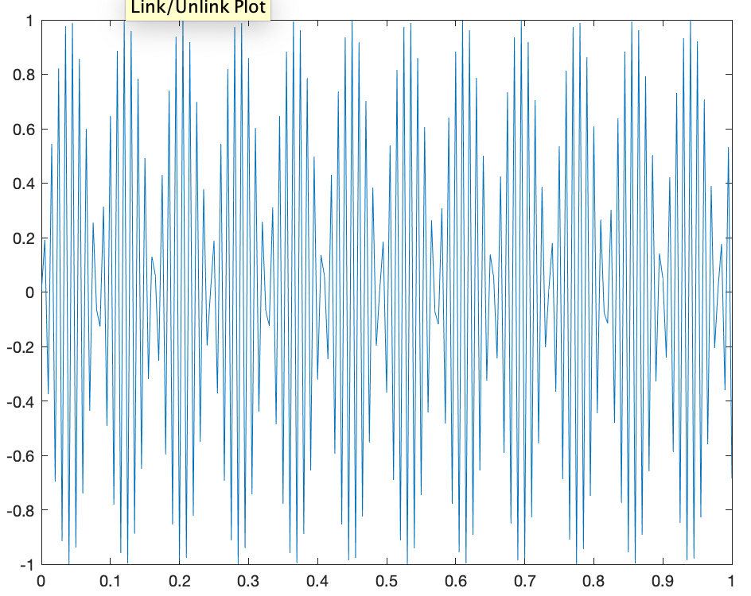
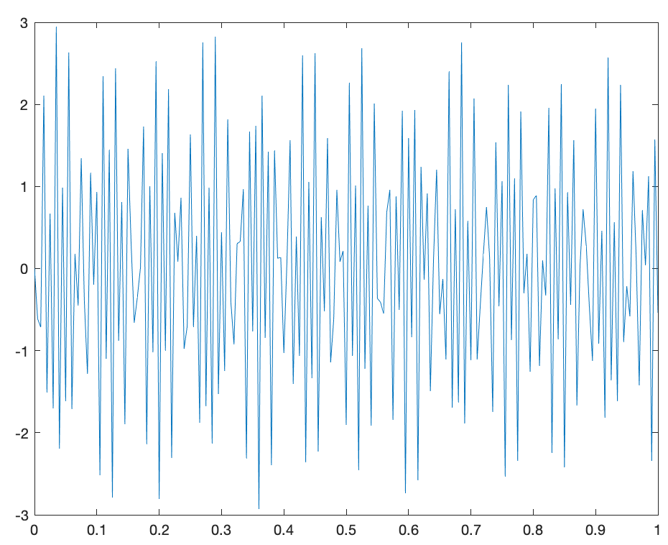
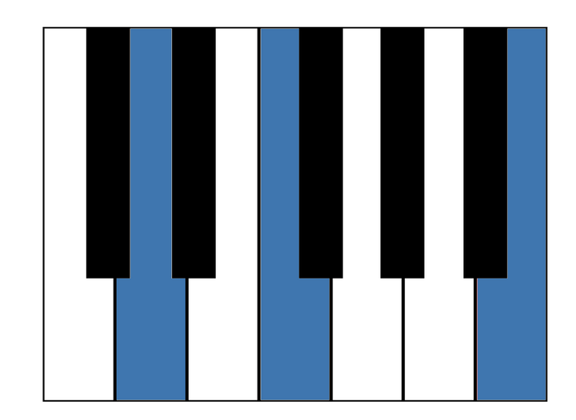
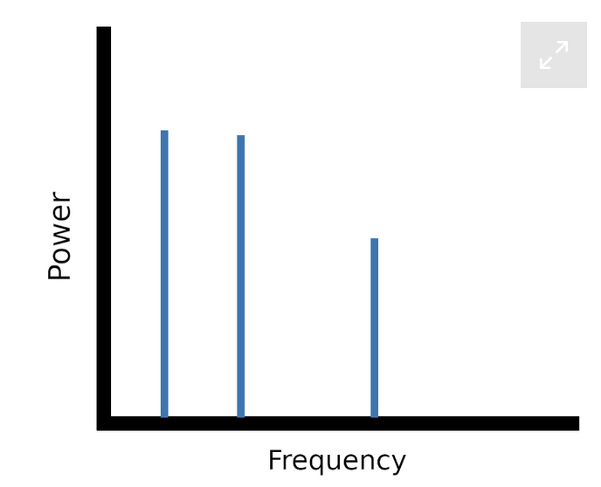
Time vs. Frequency Domain
D
F
B

Slide 26
Time vs. Frequency Domain
Fast Fourier Transform (fft)
D
F
B

Slide 27
Activity 2: Identify Frequency Components using fft()

Slide 28
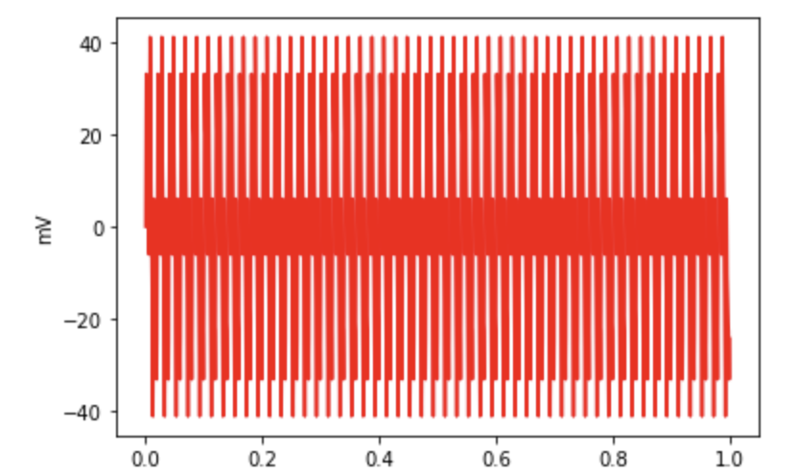
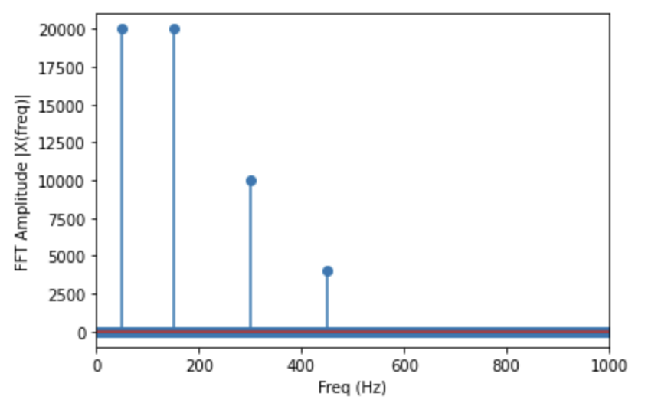
Activity 2: Identify Frequency Components using fft()
Time Domain
Frequency Domain
Time Domain

Slide 29
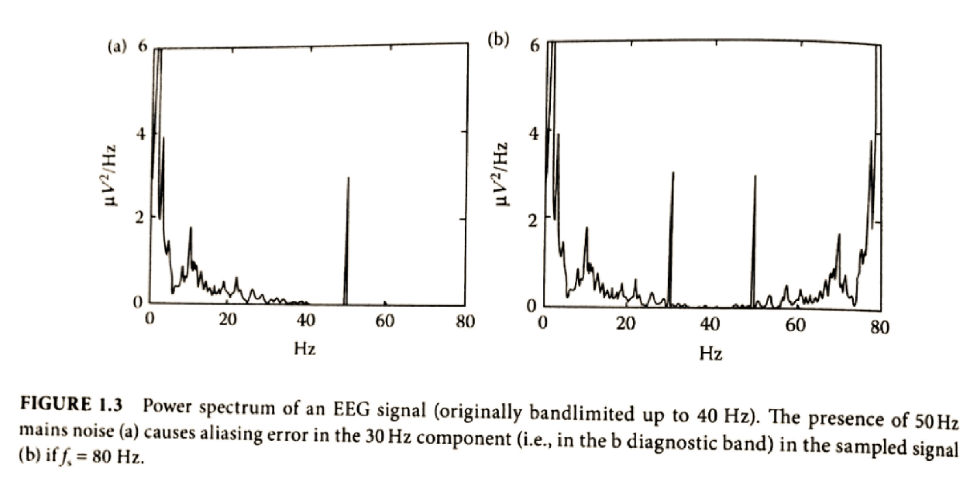
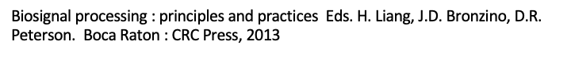
Aliasing in the Frequency Domain?
Notes:
I will not go into the mathematical detail behind the algorithm (you can do that outside this course) but to convert between time and frequency you use fft()

Slide 30
Part 3:
Noise
Notes:
Now that we have sampled our signal and reconstructed it, let’s consider how we can visualize our signal in both the time and frequency domains

Slide 31
Noise affects all parts of acquisition
Noise!
Physiological Energy
Measuring Equipment
Transducer
Computer
Noise!
Amplifier
Analog-Digital Converter
Signal Processing
Noise!
Feature Extraction
Classification
Notes:
Especially for biosignals, noise is an important consideration because it can affect all aspects of acquisition. With biosignals being on the order of uV, if we do not eliminate noise in our signal, it will quickly drown out what we are trying to measure

Slide 32
Sources of Noise
Measurement noise from:
Electrodes
Movement, coupling to skin changes
Thermal noise àcaused by thermal agitation of electrons in a conductor
Electronic components in the measurement circuit
Amplifiers, resistors, etc each contribute some noise to the signal
Electrical sources in the surrounding environment
e.g. 60 Hz AC noise from power lines, fluorescent lights

Slide 33
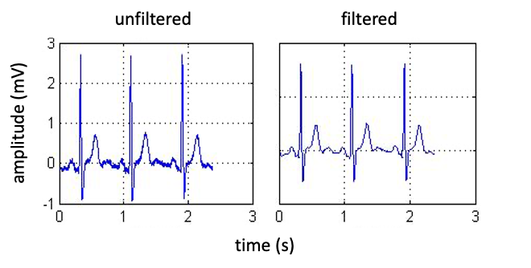
Sources of Noise
60Hz noise (Mains Hum)

Slide 34
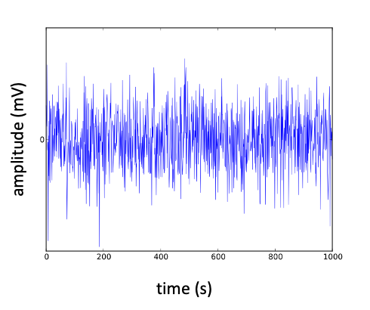
Sources of Noise
White noise

Slide 35
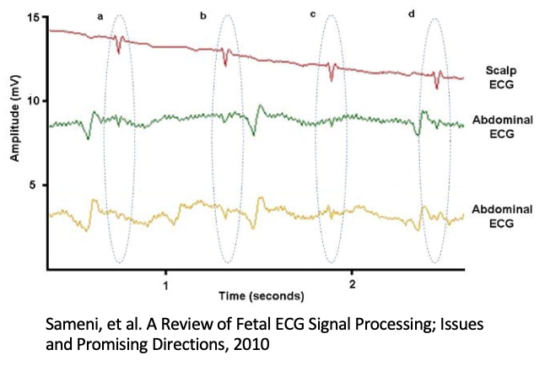
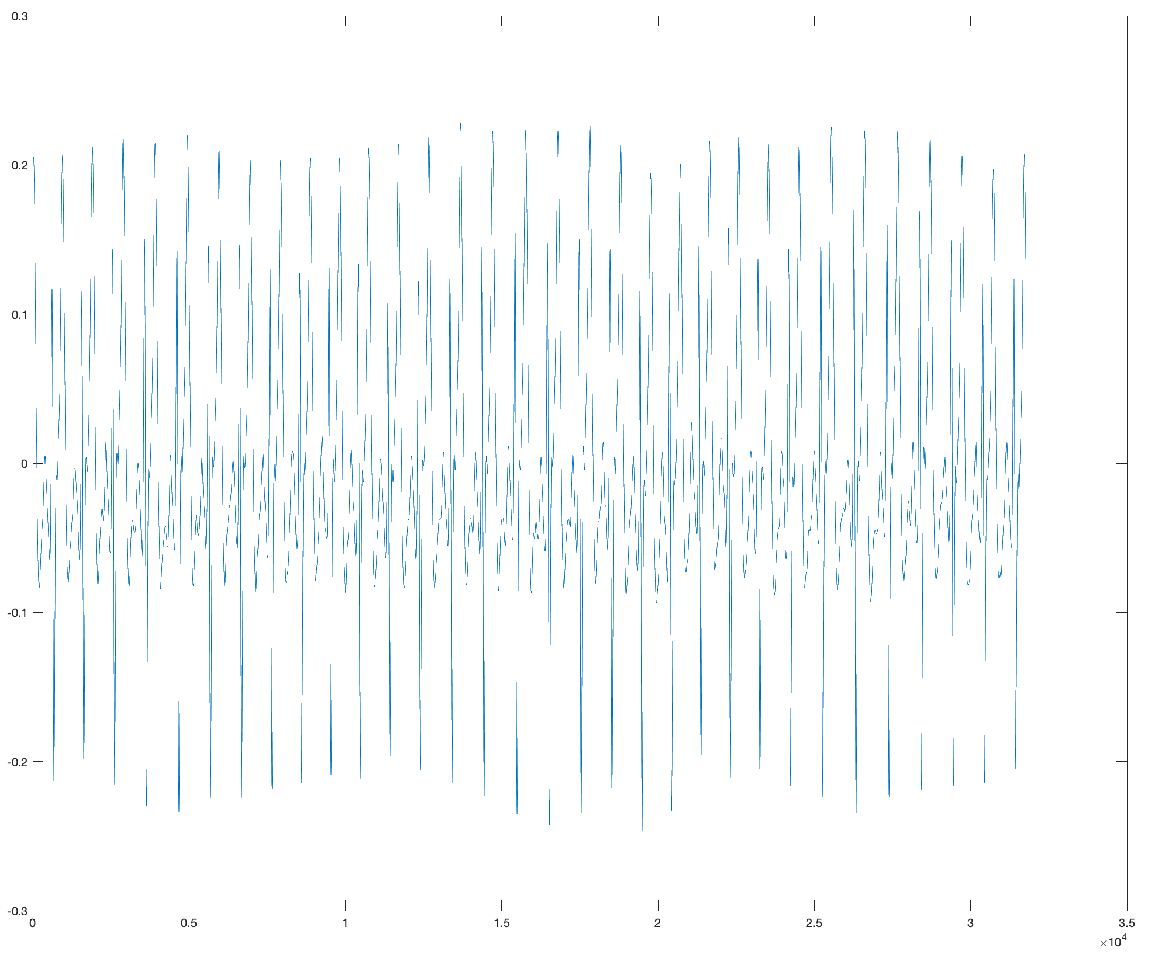
Sources of Noise
Physiological Noise
e.g. heart rate or respiration in MRI

Slide 36
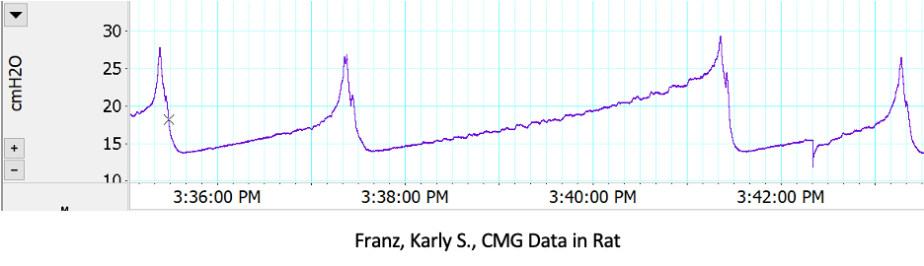
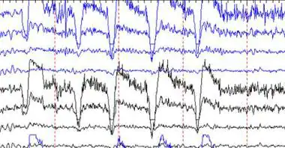
Sources of Noise
Motion Artifact

Slide 37
Activity 3: How does noise affect our signal in time and frequency domains?

Slide 38
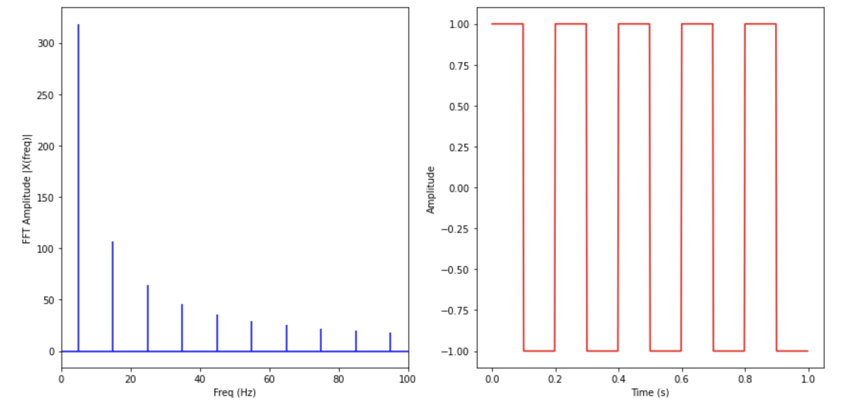
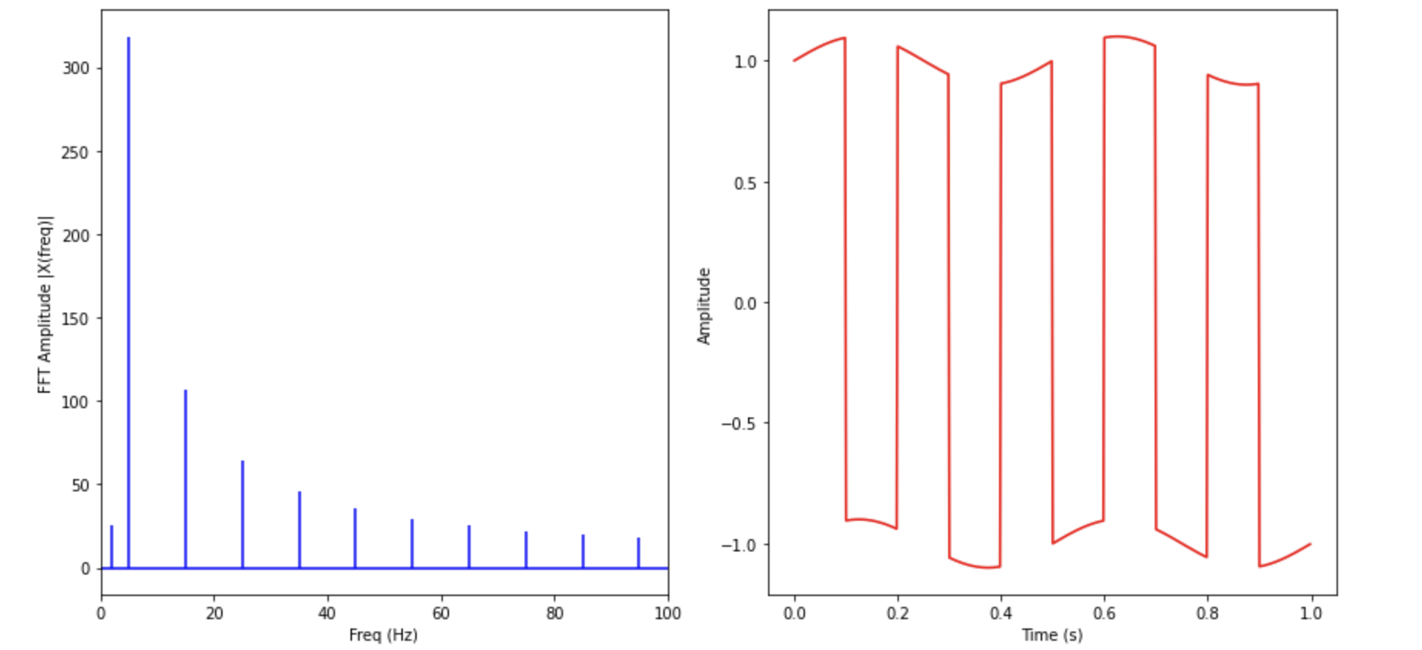
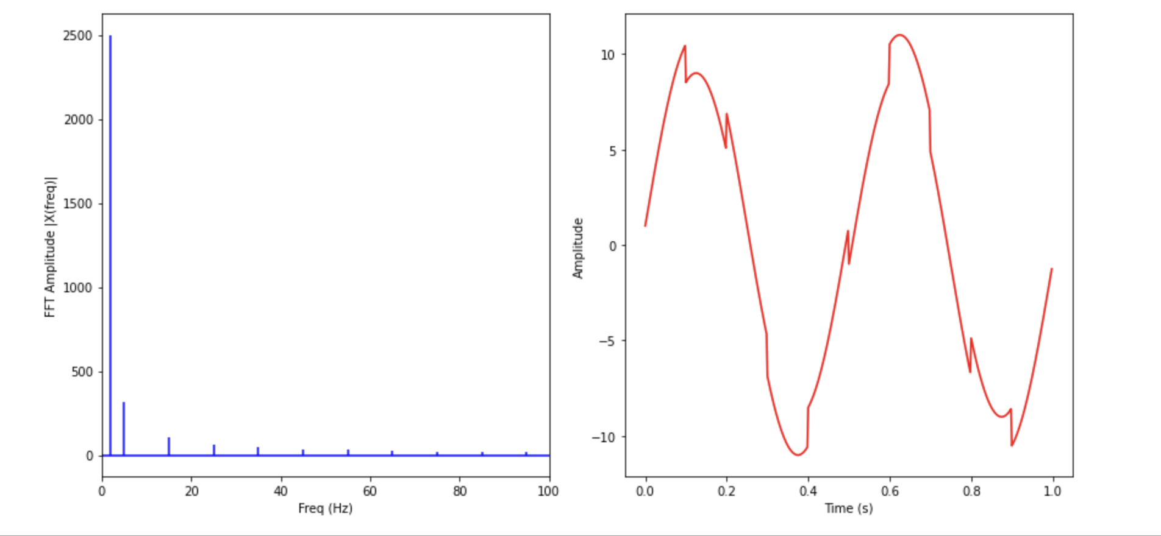
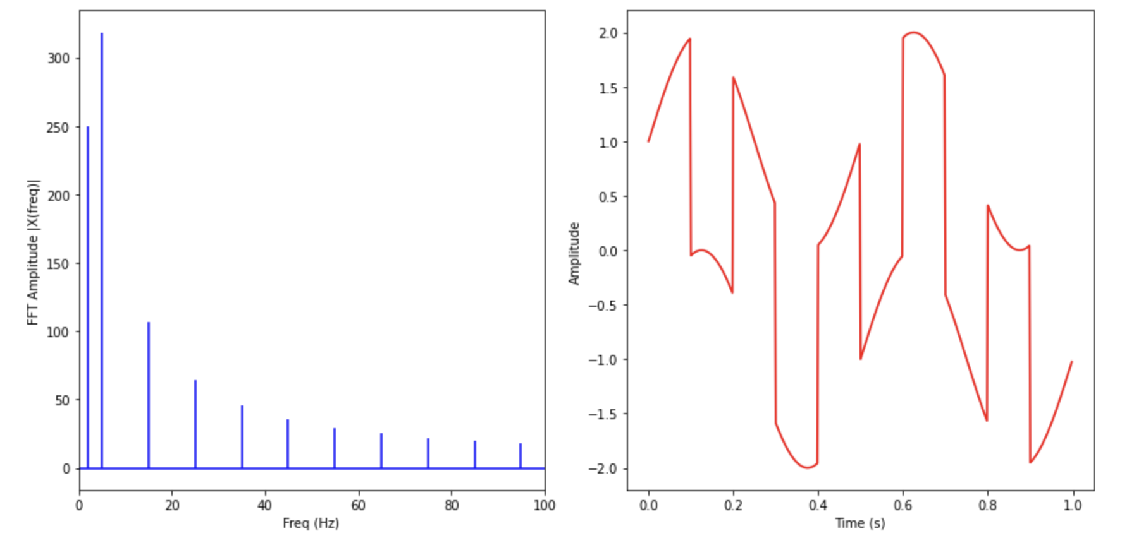
“Respiration” (Physiological) noise
No Noise
Amp = 0.1
Amp =1
Amp = 10

Slide 39
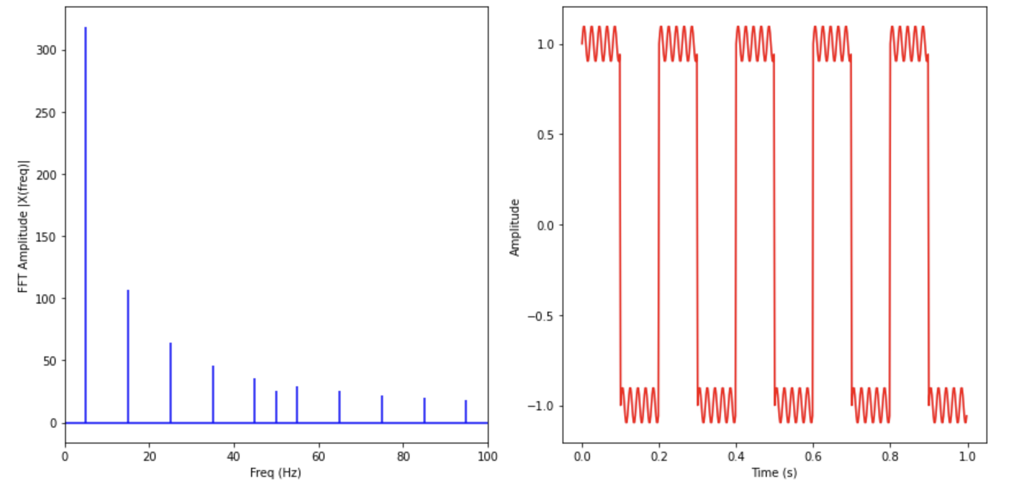
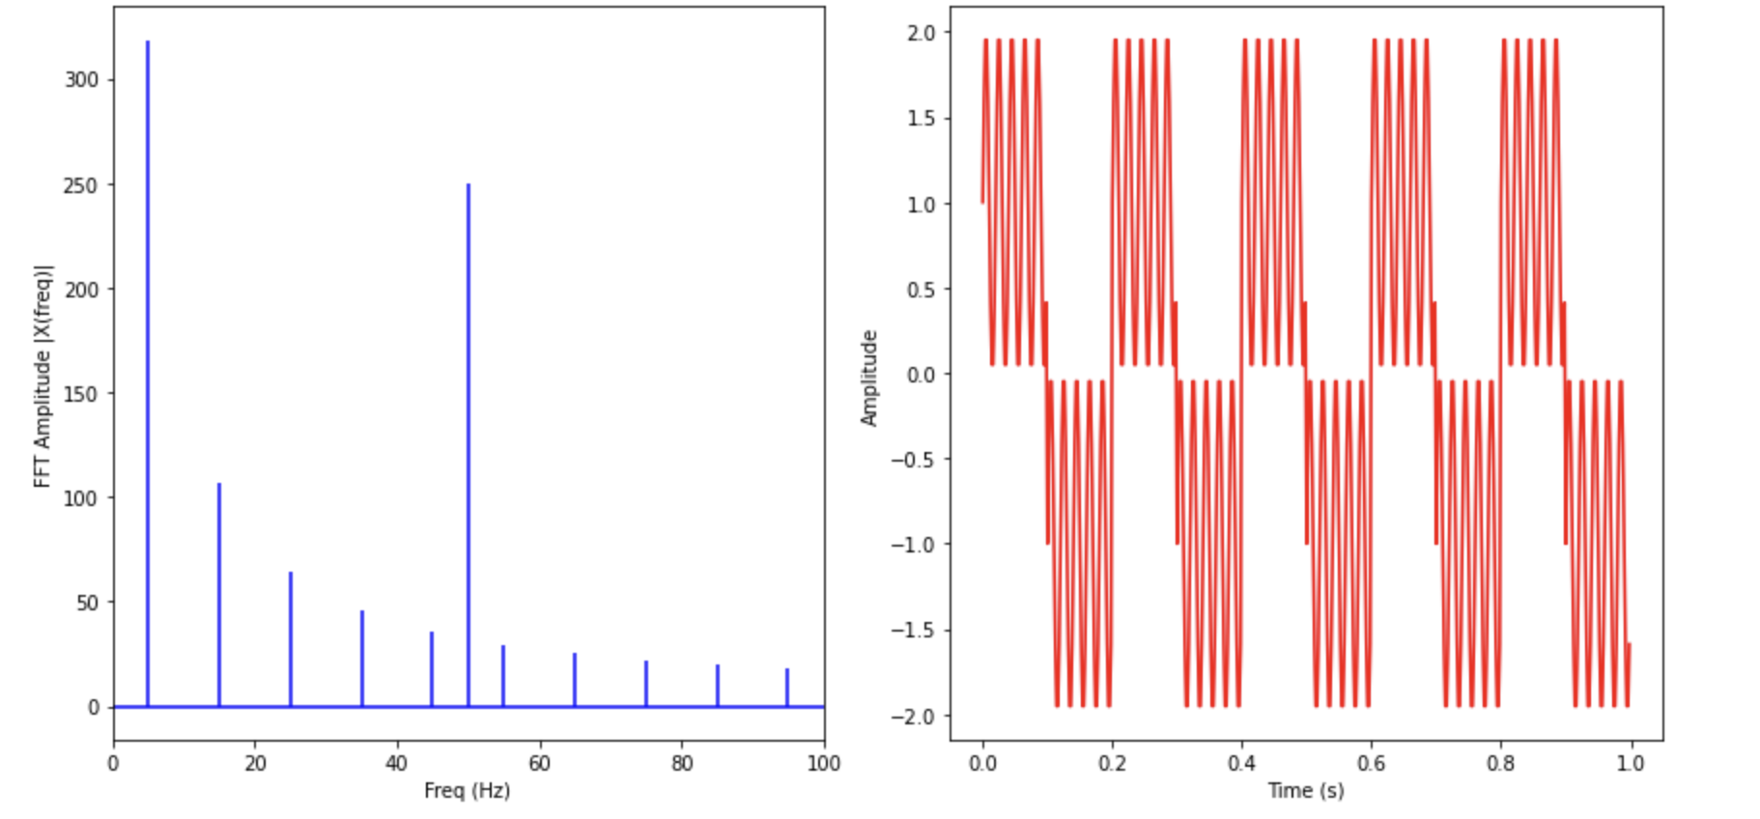
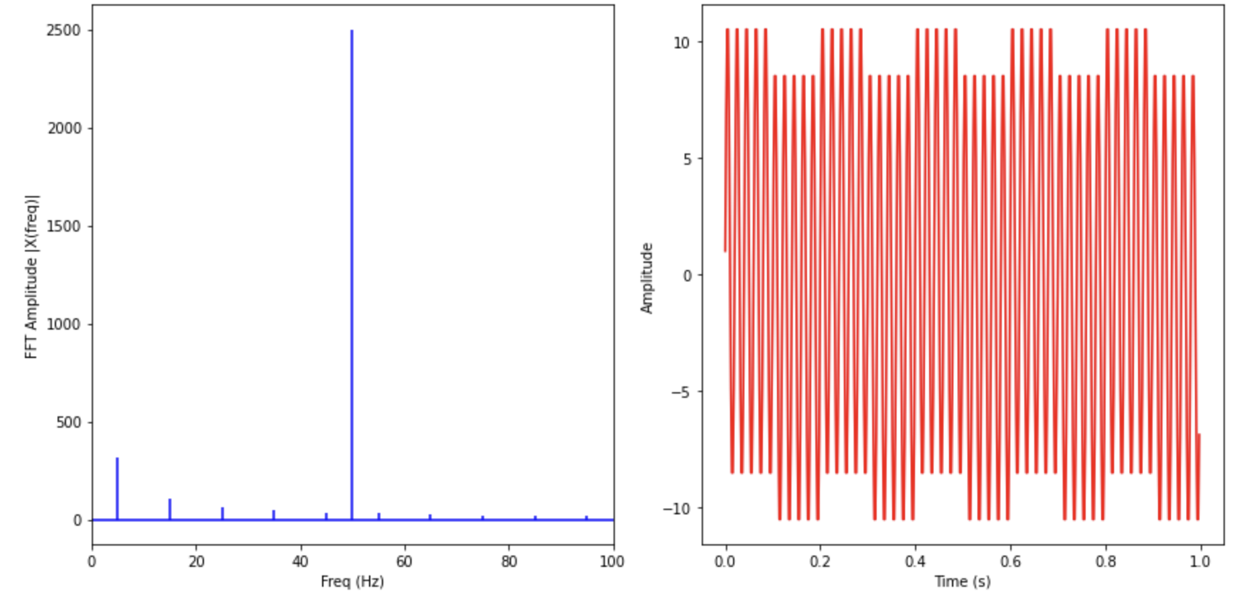
Mains Hum
No Noise
Amp = 0.1
Amp =1
Amp = 10

Slide 40
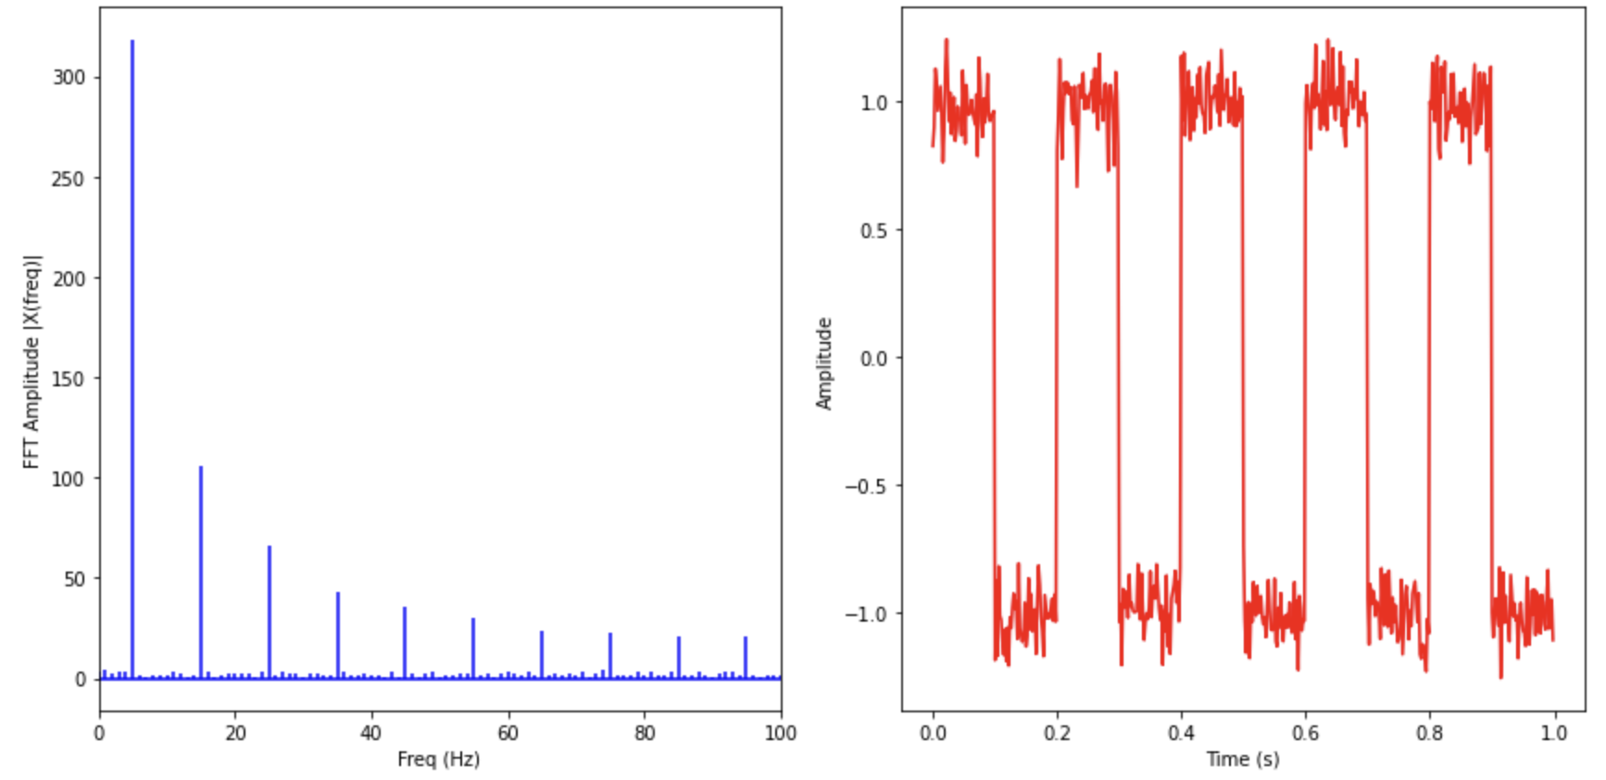
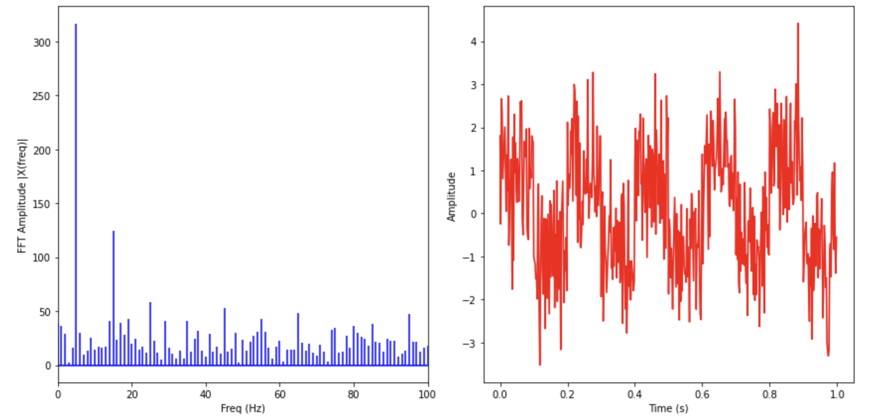
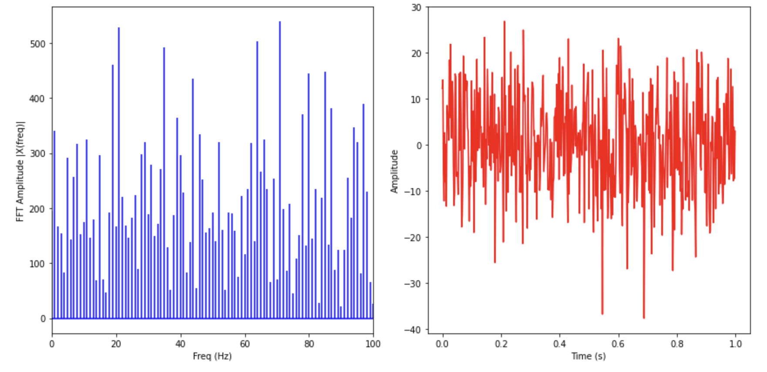
White Noise
No Noise
Amp = 0.1
Amp =1
Amp = 10

Slide 41
Part 4:
Filtering

Slide 42
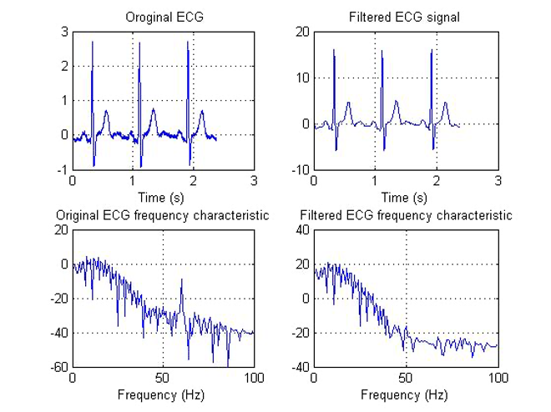
Noise can easily be identified in the frequency domain

Slide 43
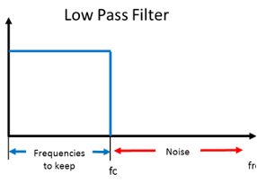
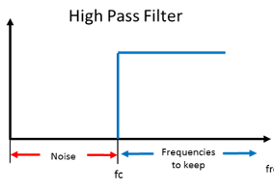
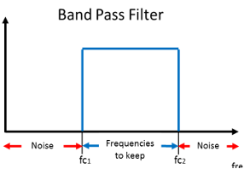
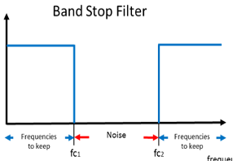
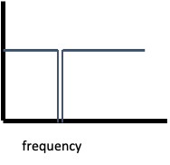
How can we remove noise?
Digital Filters can be used to eliminate noise
Notch filter….

Slide 44
Example: “Respiration” (Physiological) noise
No Noise
Amp =1

Slide 45
Example: Mains Hum
No Noise
Amp =1

Slide 46
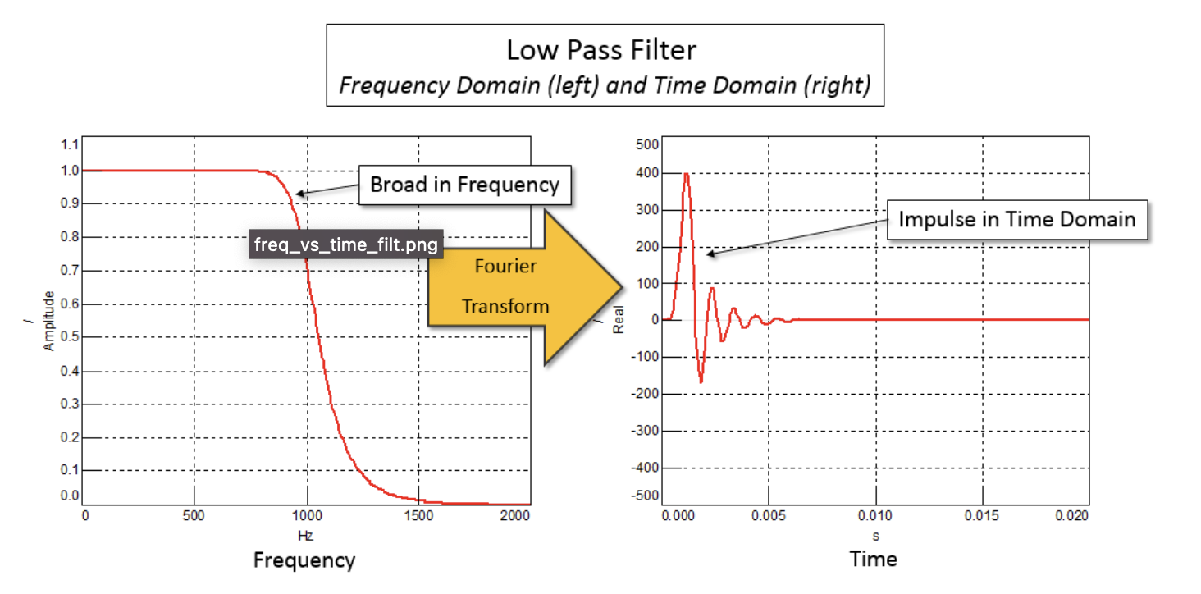
How do Filters work?
Impulse response is the filter response in the time domain

Slide 47
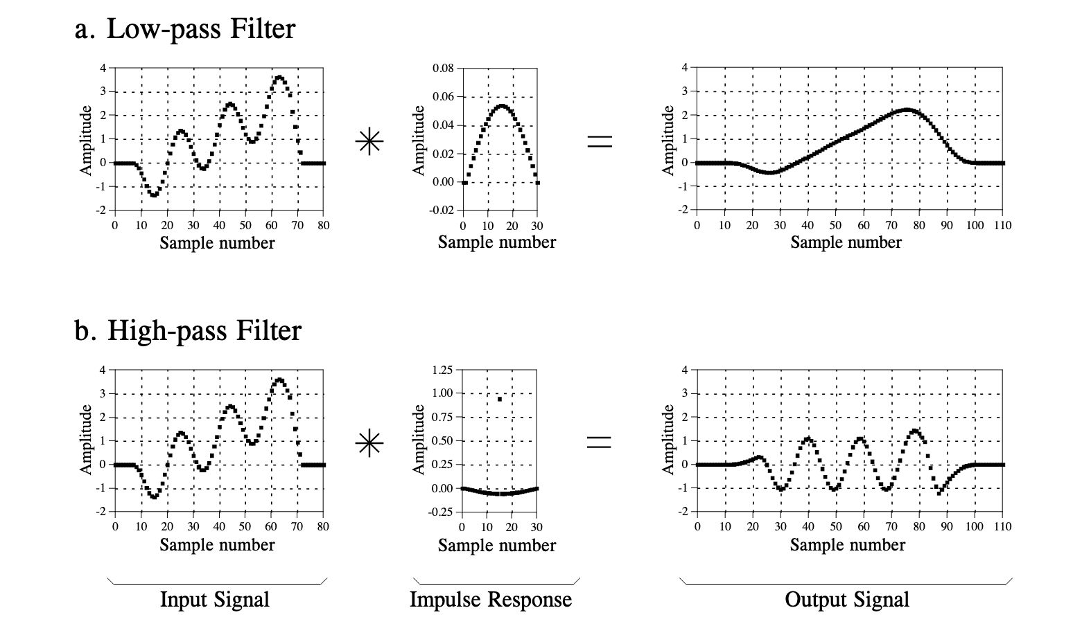
How do Filters work?
Convolution

Slide 48
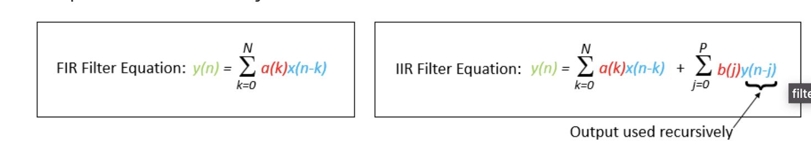
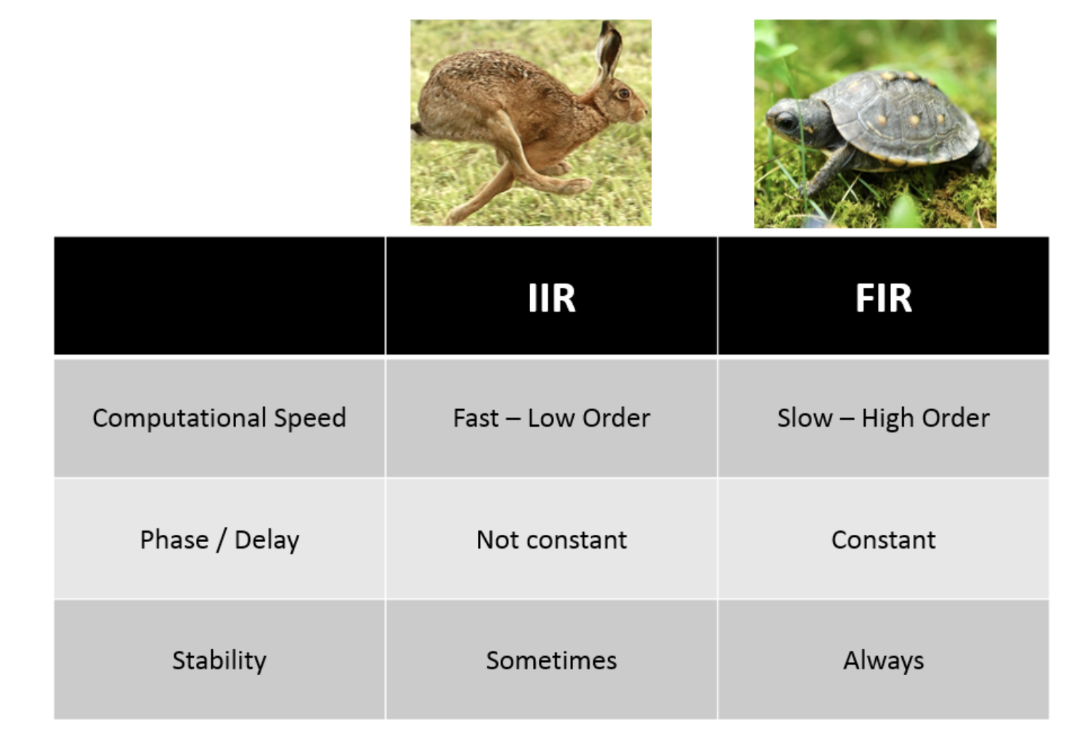
How do Filters work?
FIR and IIR filters
https://community.sw.siemens.com/s/article/introduction-to-filters-fir-versus-iir

Slide 49
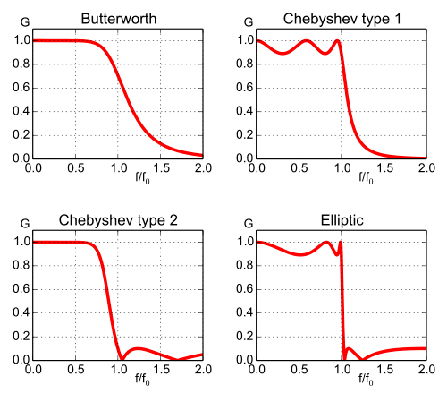
Filter Design Considerations: Filter Types

Slide 50
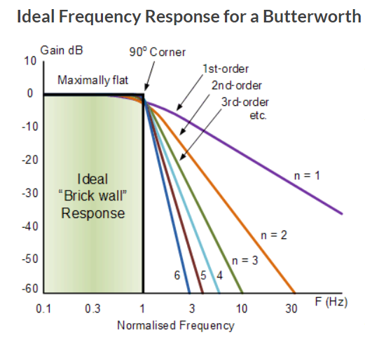
Filter Design Considerations: Filter Order

Slide 51
Activity 4: Let’s build filters and apply them!

Slide 52






Activity 4: Let’s build filters and apply them!
Fc1 = 10 Hz; fc2 = 30 Hz; order = 2
Fc1 = 18 Hz; fc2 = 22 Hz; order = 2
Fc1 = 18 Hz; fc2 = 22 Hz; order = 6

